Slide 1
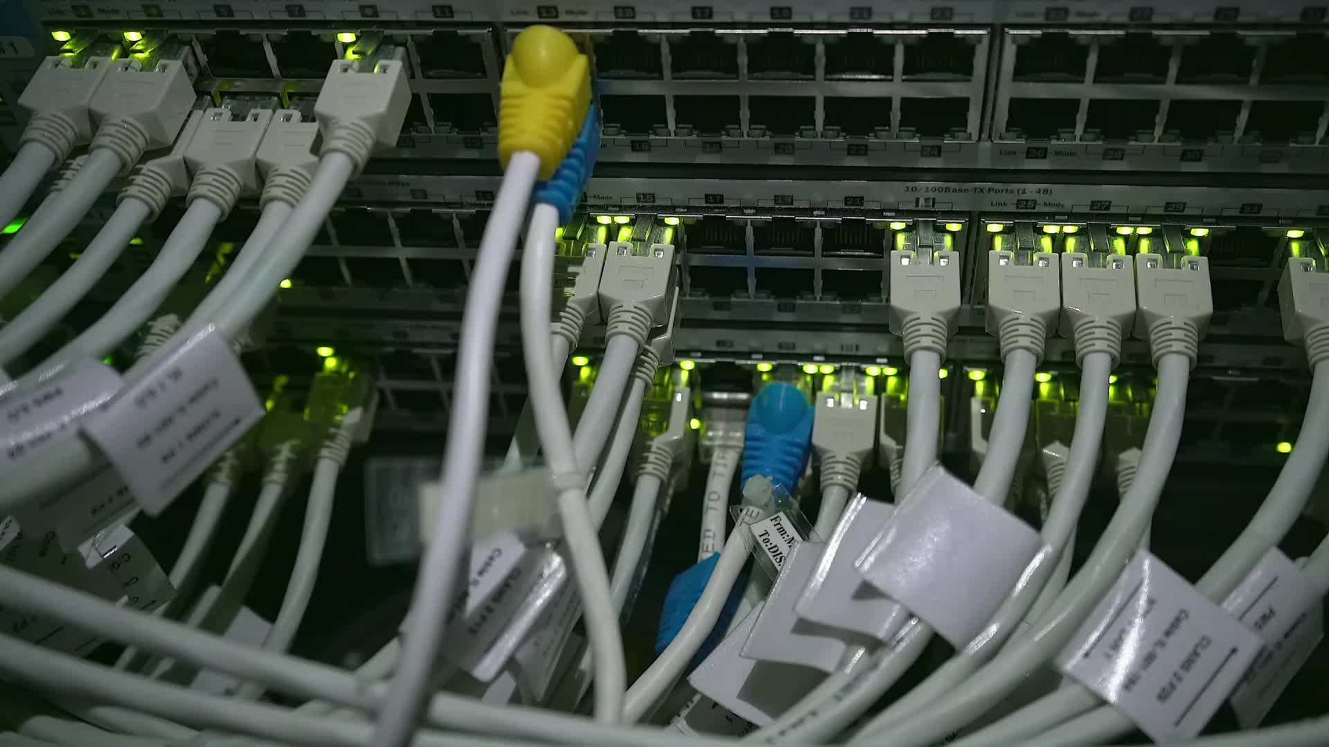
IE1020 NETWORK FUNDAMENTALS

Slide 2
Group details
Y1S2 CSNE 01.02 – Group 17
Student ID | Student Name
IT22146038 | Adheel Ahmed
IT22275424 | Ahmed S
IT22122278 | M.R.M. Rajih Husny
IT22199980 | Samaji Viranja
IT22179562 | Dewmie Senarathne

Slide 3
Introduction
XYZ University is a huge university with seven campuses spread across the country.
The University’s network used by nearly 50,000 students, faculty and staff members.
The university’s IT department is responsible of designing and maintaining the network infrastructure across all campuses.

Slide 4
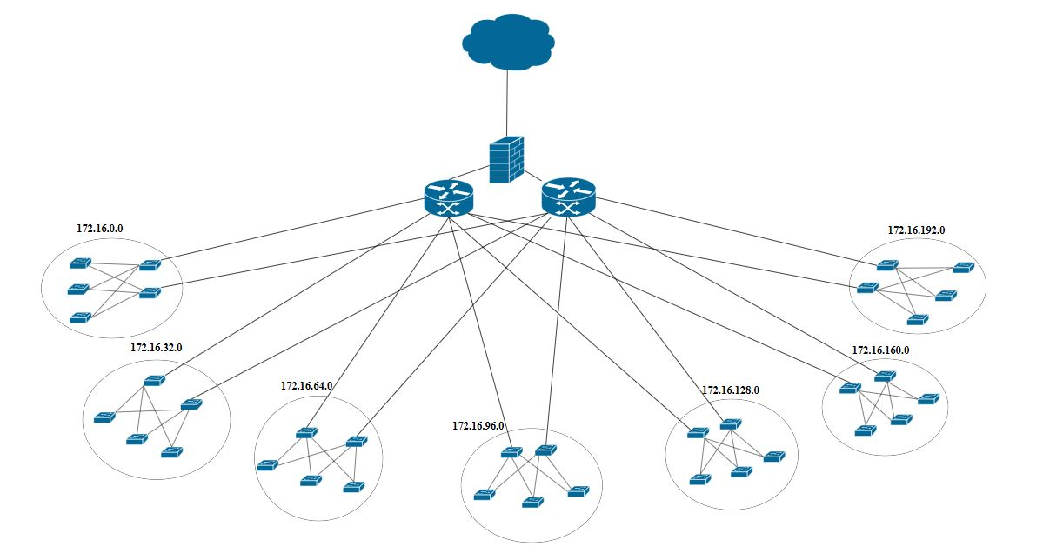
Logical topology

Slide 5
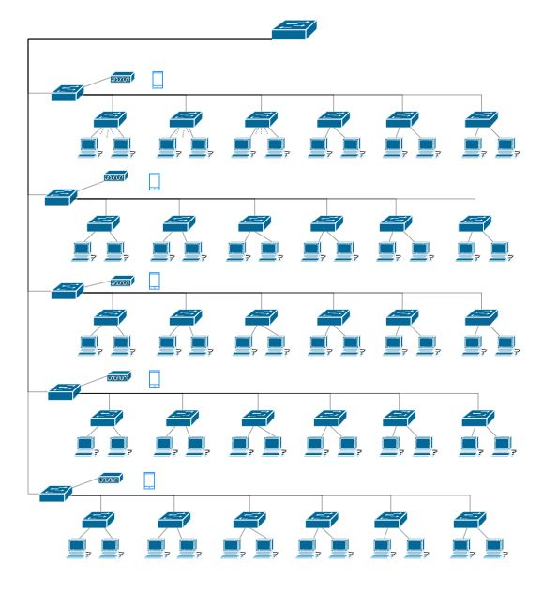

Slide 6
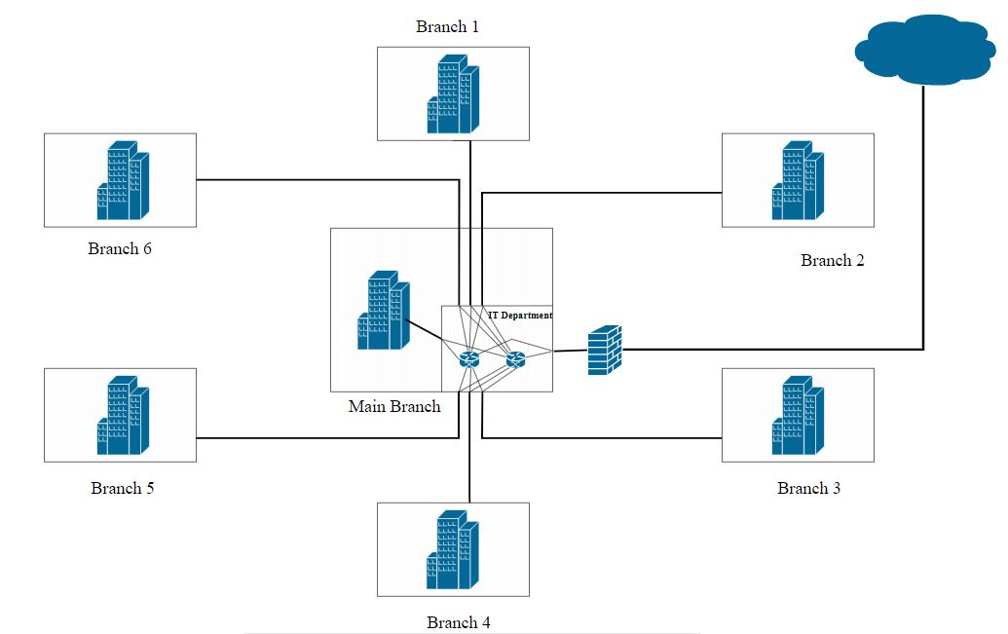
Physical topology – Core Layer

Slide 7
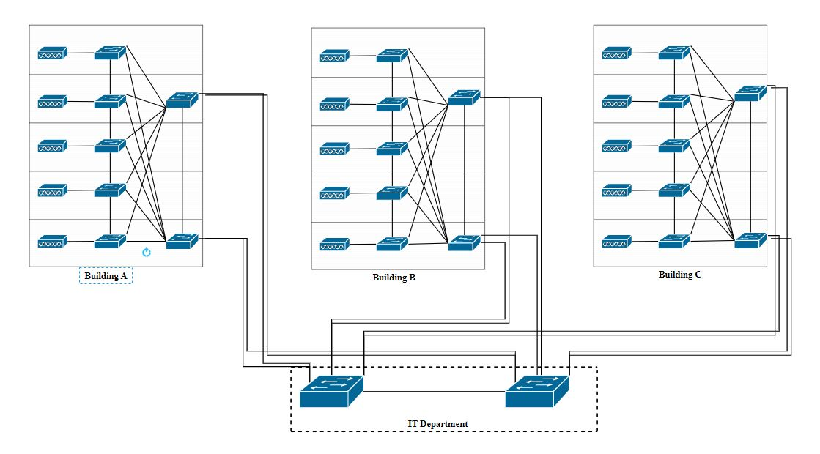
Distribution Layer

Slide 8
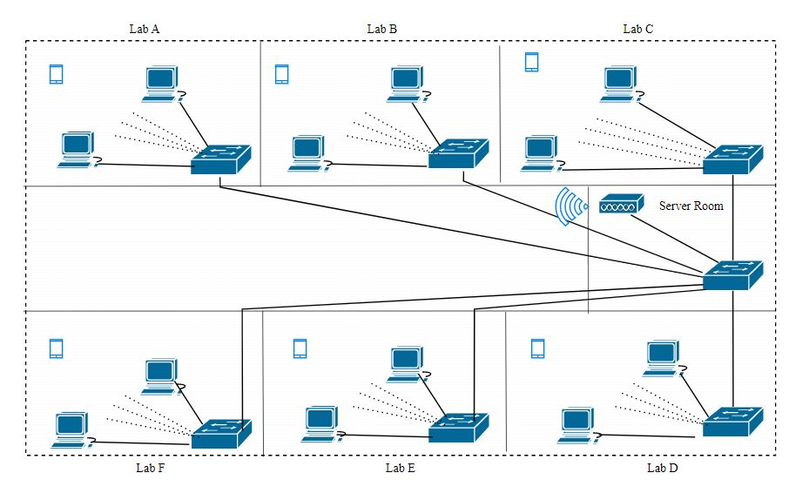
Access Layer

Slide 9
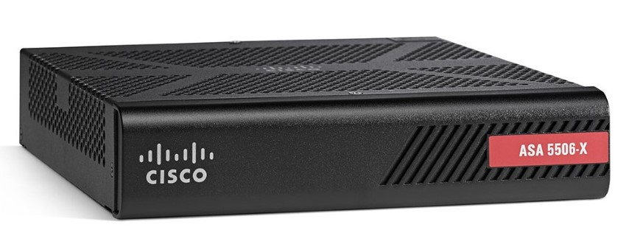
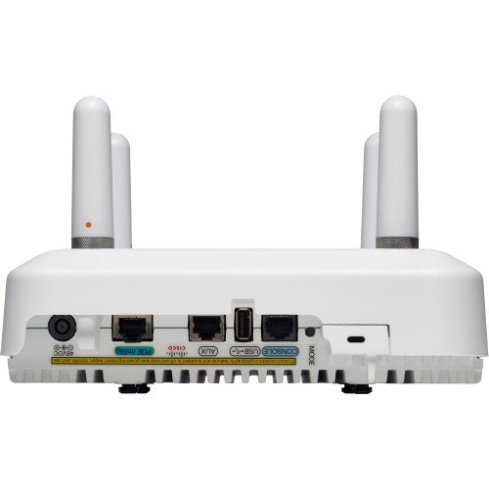
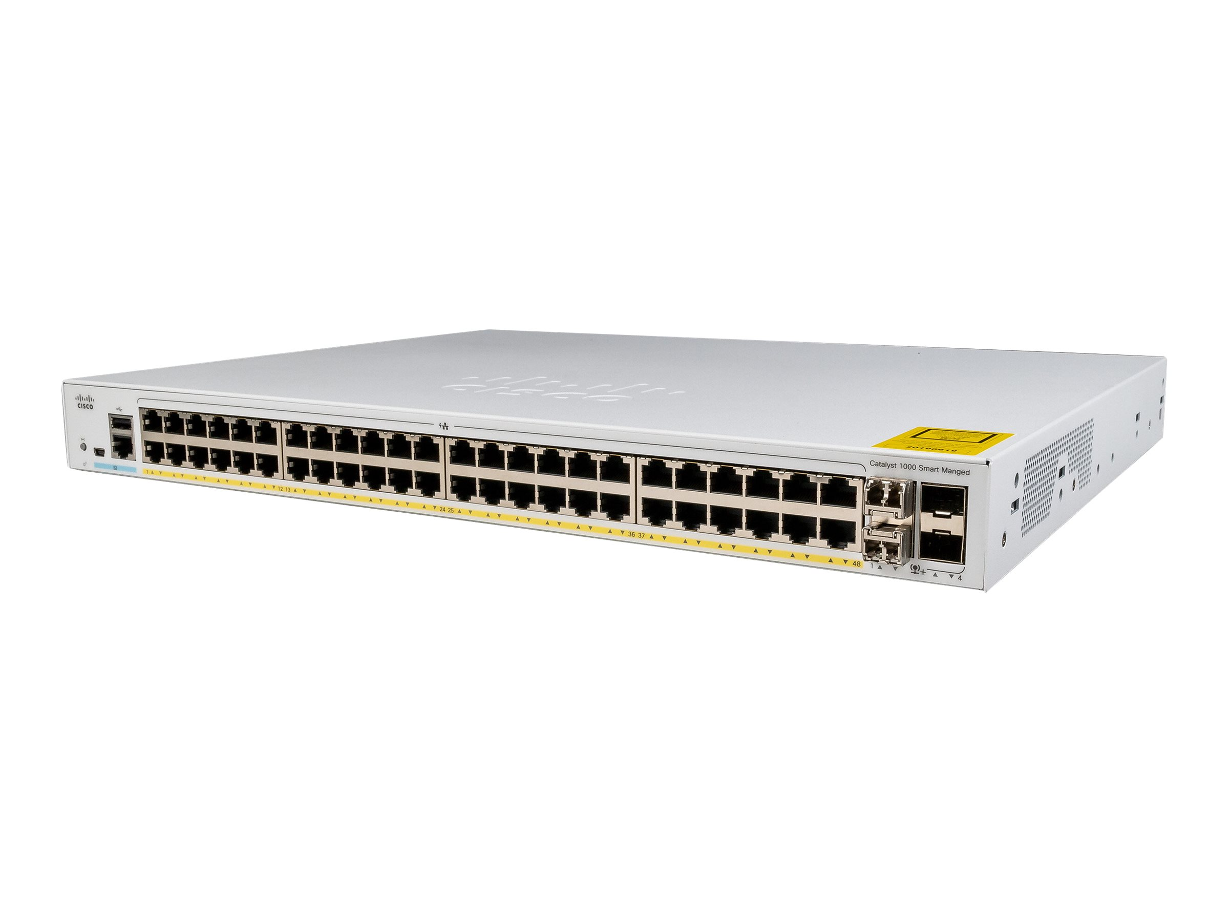
Suggested Real Devices
Access point – Cisco Aironet 3800 series (AIR-AP3802E-B-K9 – Cisco Aironet 3802E)
Firewall – Cisco ASA 5506-X
Switch – Cisco 1000 series (C1000FE – 48P – 4G – L) - 48 ports
- Cisco Catalyst 3850 (WS-C3850-12S-E) – 12 ports
Cisco 110 series (SG 110D – 08) - 8 ports
Router – Cisco ASR1000 series (Cisco ASR1002-HX)

Slide 10
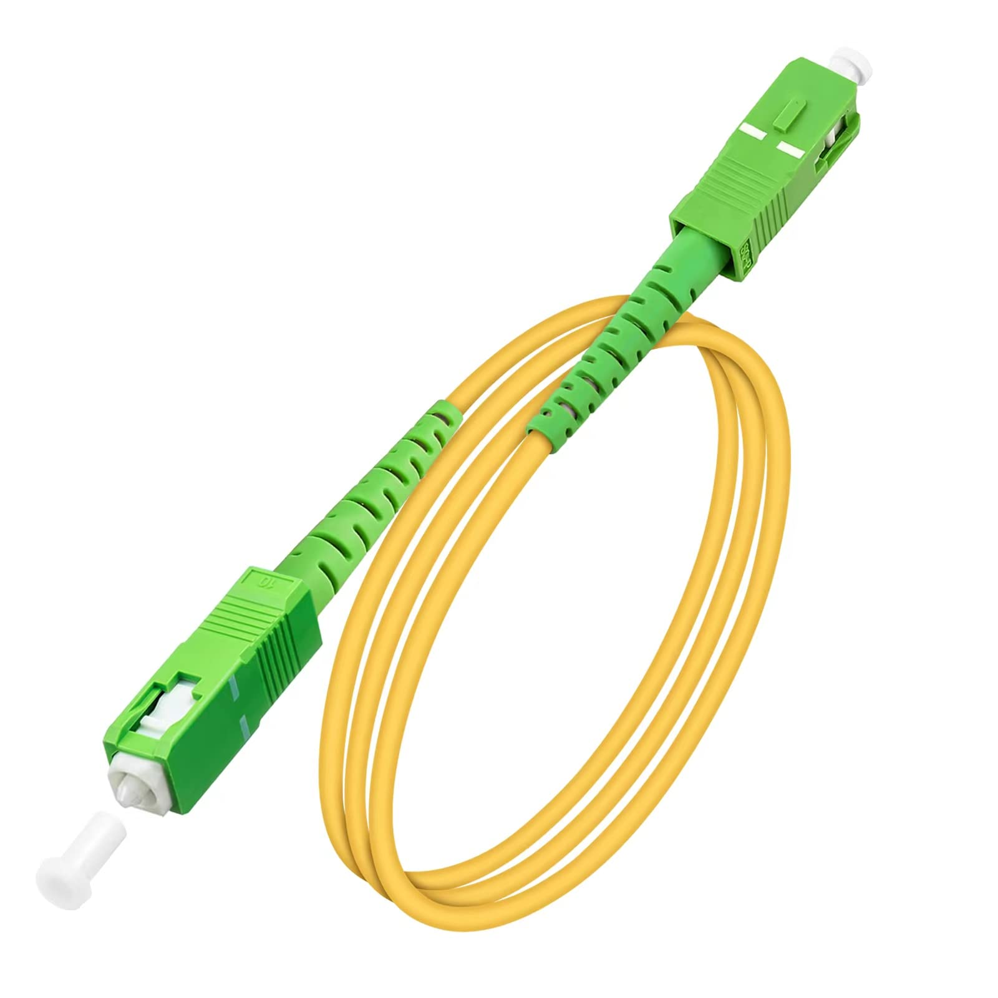
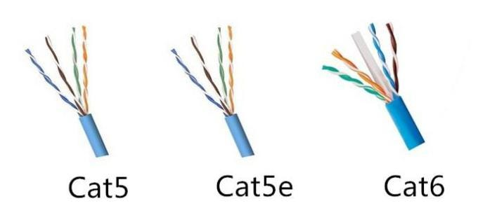
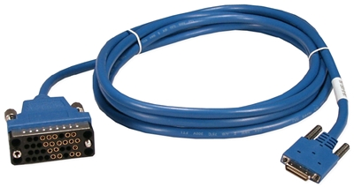
Suggested Media Types
Ethernet cat5 – to connect devices to the switch in the lab
Ethernet cat5e – to connect the 6 lab switches to the floor switch
Ethernet cat6 – to connect the switches in the distribution layer
Fiber cable – to connect the switches in the core layer to the router
Serial cable – to connect two routers

Slide 11
LAN Technologies
Fast Ethernet
Gigabit Ethernet
Wireless LAN
WAN Technologies
Fiber optic cable

Slide 12
Protocols For ISO/OSI Layered Architecture
Layer 1 (Physical) – Fiber , IEEE802.11
Layer 2 (Data Link) – Ethernet , STP , ATM
Layer 3 (Network) – IP , EIGRP , ARP
Layer 4 (Transport) – TCP , UDP
Layer 5 (Session) – SCP
Layer 6 (Presentation) – SSL , SSH
Layer 7 (Application) – HTTP , SMTP , DNS

Slide 13
IP addressing
Private IP Address – 172.16.0.0
Subnet Mask – 255.255.224.0
Branch | Network Address | Broadcast Address | 1st usable IP Address | Last usable IP Address
Main Branch | 172.16.0.0 | 172.16.31.255 | 172.16.0.1 | 172.16.31.254
Branch 1 | 172.16.32.0 | 172.16.63.255 | 172.16.32.1 | 172.16.63.254
Branch 2 | 172.16.64.0 | 172.16.95.255 | 172.16.64.1 | 172.16.95.254
Branch 3 | 172.16.96.0 | 172.16.127.255 | 172.16.96.1 | 172.16.127.254
Branch 4 | 172.16.128.0 | 172.16.159.255 | 172.16.128.1 | 172.16.159.254
Branch 5 | 172.16.160.0 | 172.16.191.255 | 172.16.160.1 | 172.16.191.254
Branch 6 | 172.16.192.0 | 172.16.223.255 | 172.16.192.1 | 172.16.223.254

Slide 14
Assumptions
All the branches have equal number of students.
Each branch has 3 buildings with 5 floors each containing 6 labs.
40% of the users from each branch connect to the network wirelessly.

